Slide 1

Multilevel Monte Carlo methods
A topic for Efficient Computational Algorithms
Aditya Ujeniya
14th November 2022
With acknowledgements to Dr. Davide Baroli

Slide 2
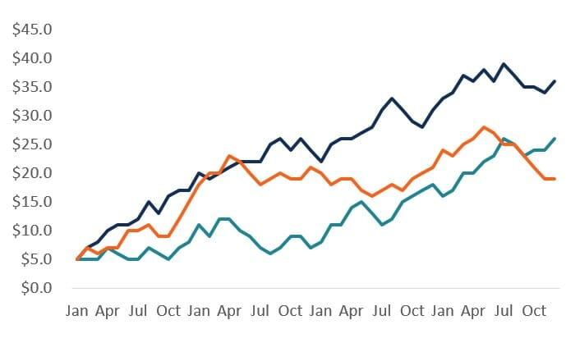
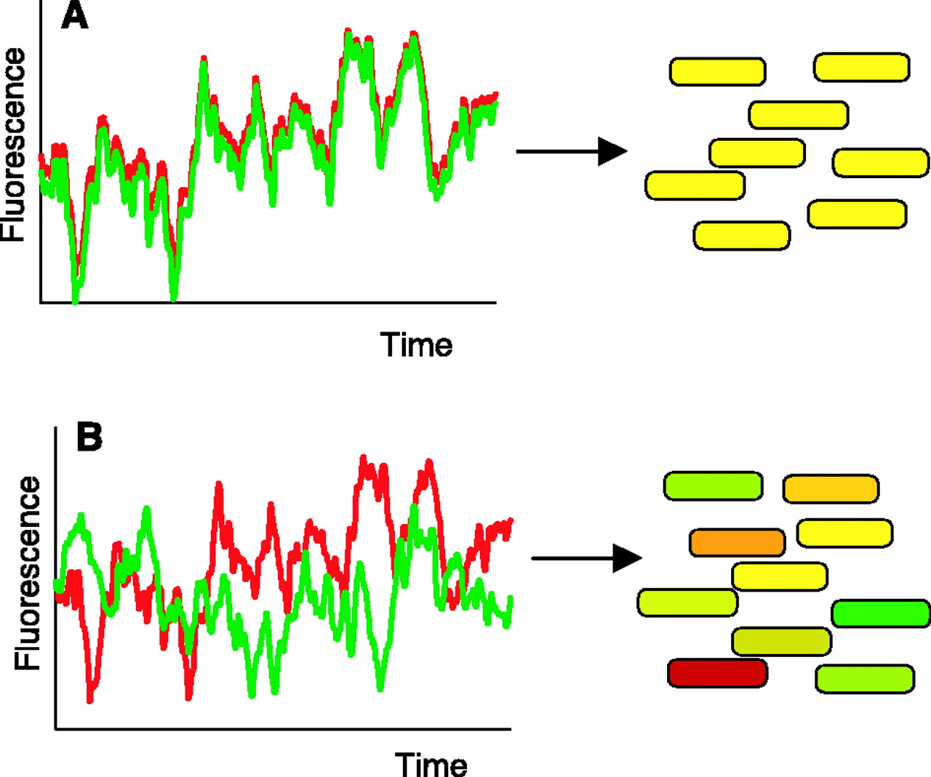
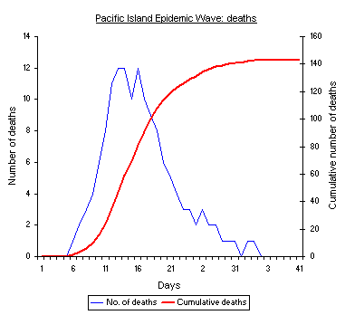
Motivation: Stochastic Systems in the Real World
Finance
Epidemics
Gene Expression

Slide 3







Example: SDE Path Simulation
We take an example of SDE(Stochastic Differential Equation) in finance, which in simpler case has this form:
where is the increment of Brownian motion, with variance .
This is usually approximated by Euler-Maruyama method:
with uniform timestep h, and increment factor with variance h.
The output of interest is a function of final value:
where is a scalar output.

Slide 4
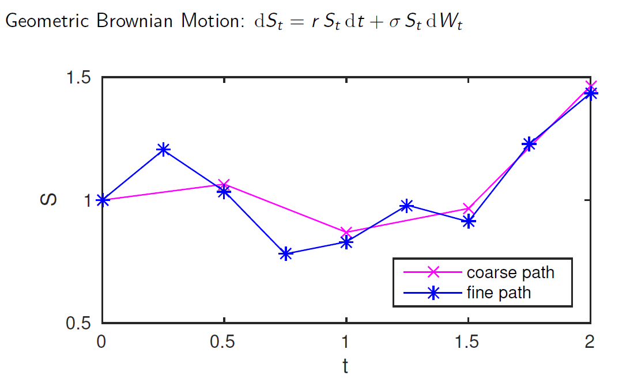
Example: SDE Path Simulation

Slide 5
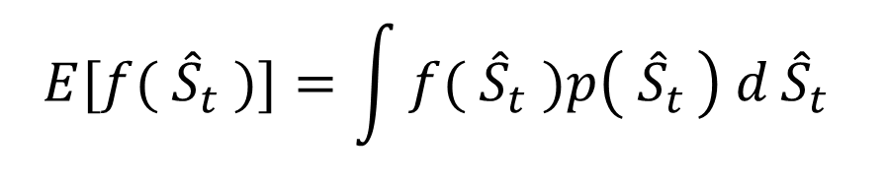
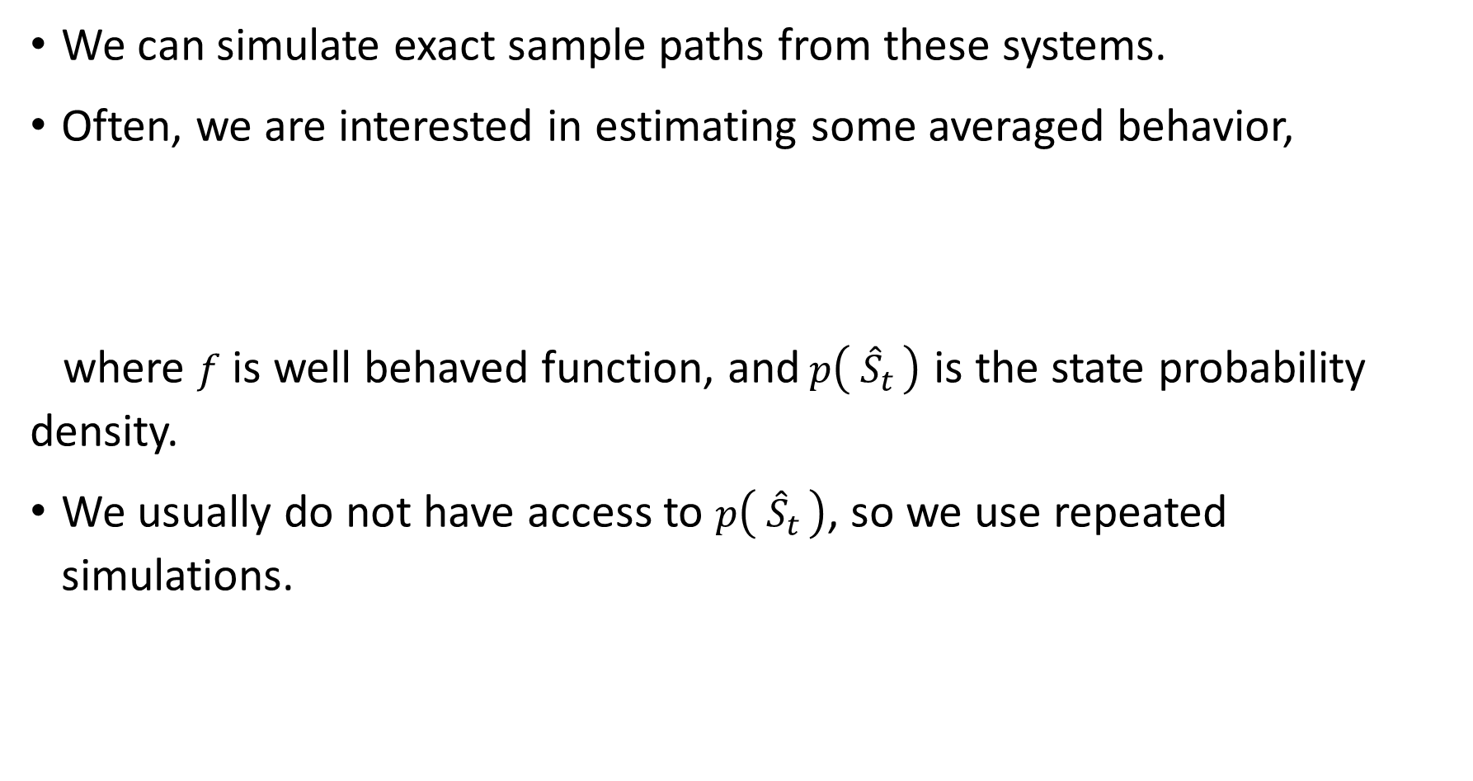
Exact Stochastic Simulation
We can simulate exact sample paths from these systems.
Often, we are interested in estimating some averaged behavior,
where $f$ is well behaved function, and$p\left( {\hat{S}}_{t }\right)$ is the state probability density.
We usually do not have access to $p\left( {\hat{S}}_{t }\right)$, so we use repeated simulations.
$$E[{f( \hat{S}}_{t} )]=\int{{f( \hat{S}}_{t} )p\left( {\hat{S}}_{t }\right) d}{\hat{S}}_{t}$$

Slide 6
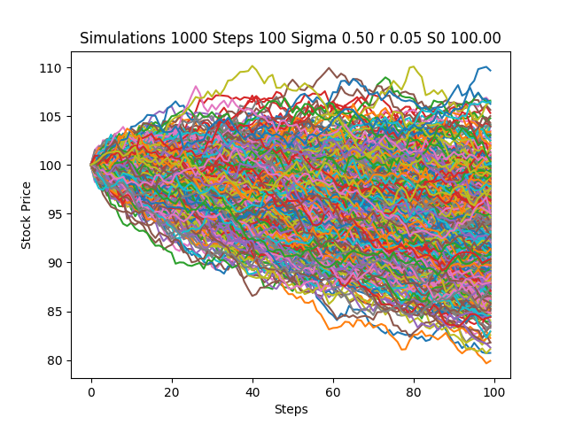
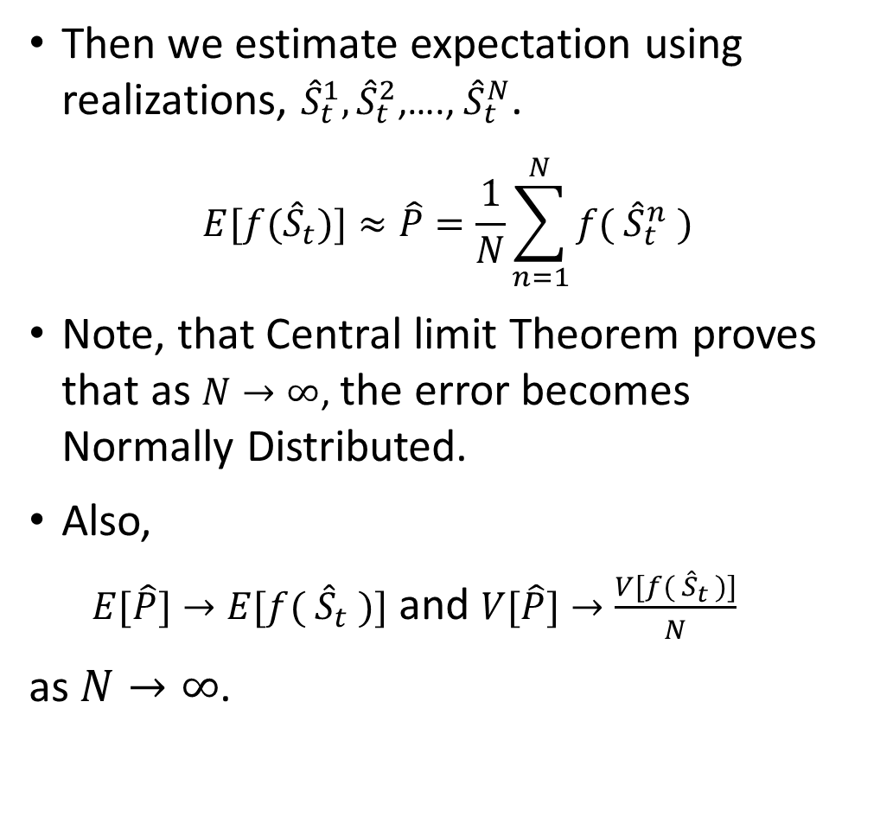
Monte Carlo Methods
Then we estimate expectation using realizations, ${\hat{S}}_{t}^{1},{\hat{S}}_{t}^{2}$,…., ${\hat{S}}_{t}^{N}$.
$$E[{f(\hat{S}}_{t})]≈\hat{P}=\frac{1}{N}\sum_{n=1}^{N}{f({ \hat{S}}_{t}^{n} )}$$
Note, that Central limit Theorem proves that as $N→∞$, the error becomes Normally Distributed.
Also,
$E[\hat{P}]→E[{f( \hat{S}}_{t} )]$ and $V[\hat{P}]→\frac{V[{f( \hat{S}}_{t} )]}{N}$
as $N→∞$.

Slide 7
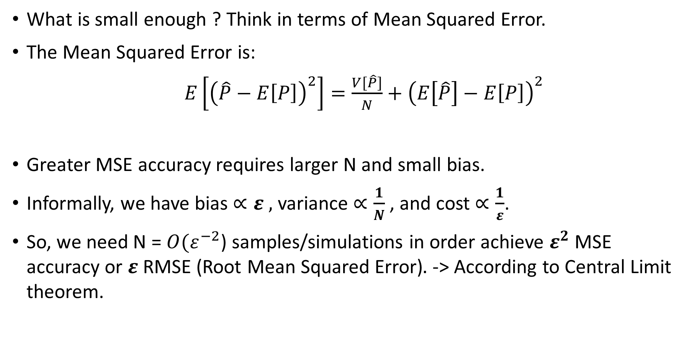
Computational Challenge
What is small enough ? Think in terms of Mean Squared Error.
The Mean Squared Error is:
$E\left[{\left(\hat{P}−E\left[P\right]\right)}^{2}\right]=\frac{V[\hat{P}]}{N}+{\left(E\left[\hat{P}\right]−E\left[P\right]\right)}^{2}$
Greater MSE accuracy requires larger N and small bias.
Informally, we have bias $∝ε ,$ variance $∝\frac{1}{N}$, and cost $∝\frac{1}{ε}$.
So, we need N = ${O(ε}^{−2}$) samples/simulations in order achieve $ε^{2}$ MSE accuracy or $ε$RMSE (Root Mean Squared Error)$.$ -> According to Central Limit theorem.
Variance Bias

Slide 8
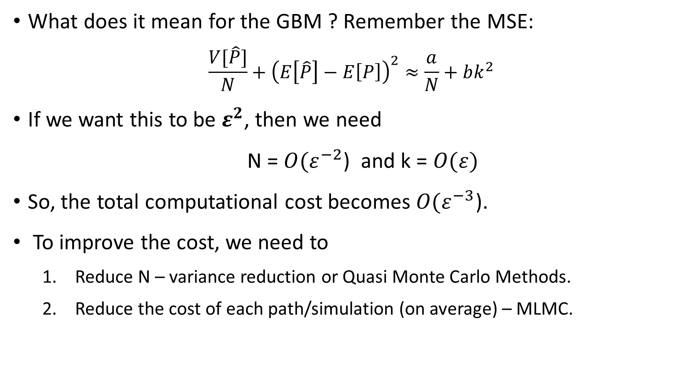
Computational Challenge
What does it mean for the GBM ? Remember the MSE:
$$\frac{V[\hat{P}]}{N}+{\left(E\left[\hat{P}\right]−E\left[P\right]\right)}^{2}≈\frac{a}{N}+bk^{2}$$
If we want this to be $ε^{2}$, then we need
N = ${O(ε}^{−2}$) and k = $O(ε)$
So, the total computational cost becomes ${O(ε}^{−3}$).
To improve the cost, we need to
Reduce N – variance reduction or Quasi Monte Carlo Methods.
Reduce the cost of each path/simulation (on average) – MLMC.

Slide 9
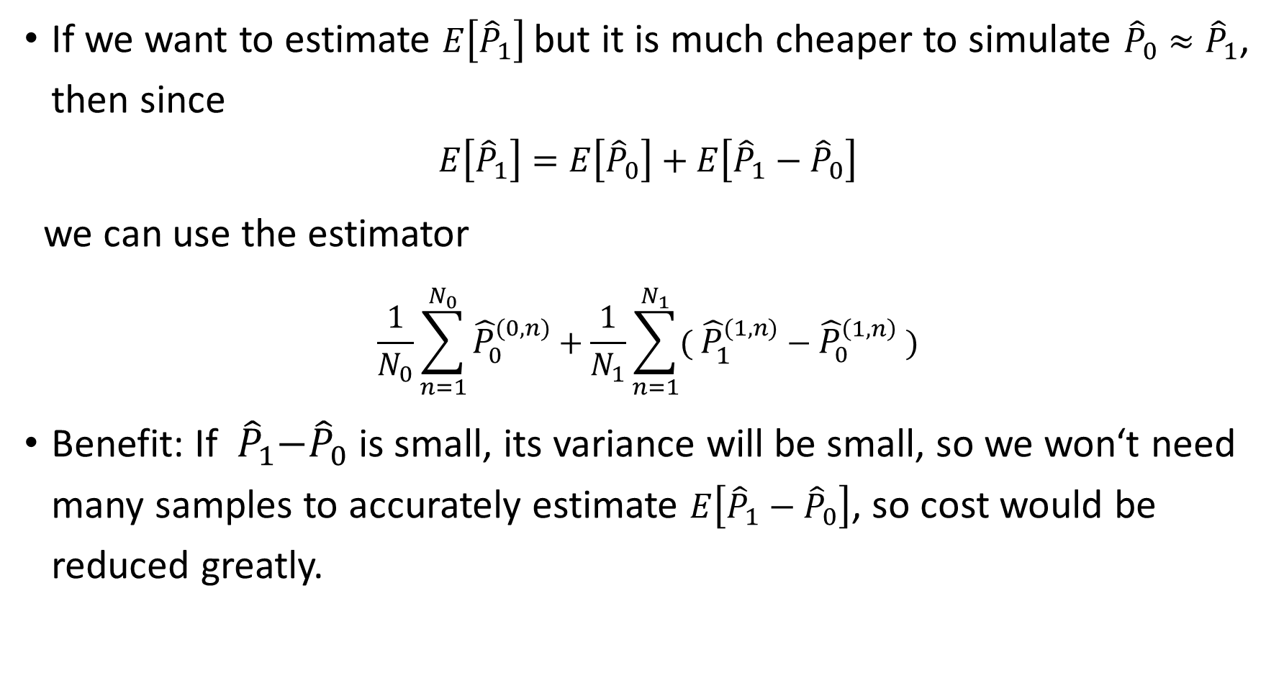
Two-level Monte Carlo
If we want to estimate $E\left[{\hat{P}}_{1}\right]$ but it is much cheaper to simulate ${\hat{P}}_{0}≈{\hat{P}}_{1}$, then since
$$E\left[{\hat{P}}_{1}\right]=E\left[{\hat{P}}_{0}\right]+E\left[{\hat{P}}_{1}−{\hat{P}}_{0}\right]$$
we can use the estimator
$$\frac{1}{N_{0}}\sum_{n=1}^{N_{0}}{{\hat{P}}_{0}^{(0,n)}}+\frac{1}{N_{1}}\sum_{n=1}^{N_{1}}{{( \hat{P}}_{1}^{(1,n)} −{ \hat{P}}_{0}^{\left(1,n\right)} )}$$
Benefit: If${ \hat{P}}_{1}−{\hat{P}}_{0}$ is small, its variance will be small, so we won‘t need many samples to accurately estimate $E\left[{\hat{P}}_{1}−{\hat{P}}_{0}\right]$, so cost would be reduced greatly.

Slide 10
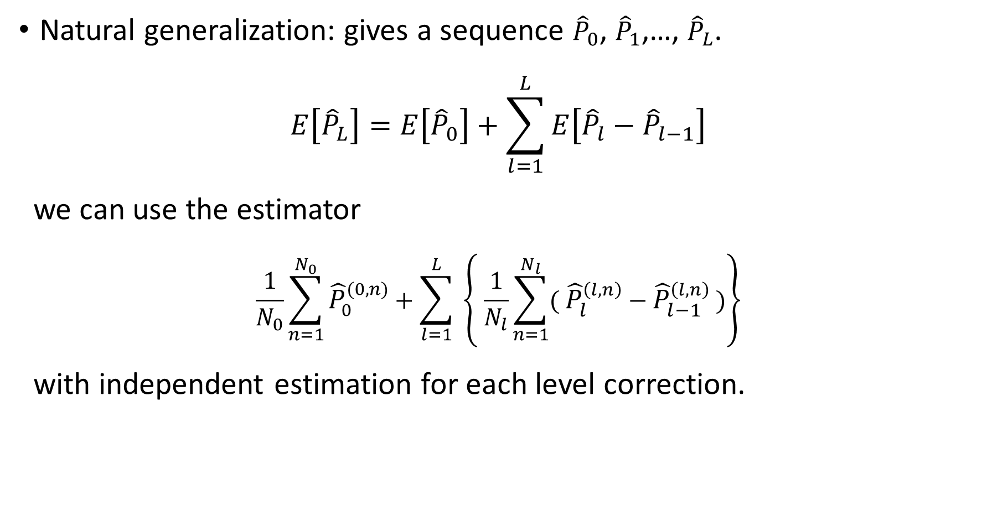
Multi-level Monte Carlo
Natural generalization: gives a sequence ${\hat{P}}_{0}$, ${\hat{P}}_{1}$,…, ${\hat{P}}_{L}$.
$$E\left[{\hat{P}}_{L}\right]=E\left[{\hat{P}}_{0}\right]+\sum_{l=1}^{L}{E\left[{\hat{P}}_{l}−{\hat{P}}_{l−1}\right]}$$
we can use the estimator
$$\frac{1}{N_{0}}\sum_{n=1}^{N_{0}}{{\hat{P}}_{0}^{(0,n)}}+\sum_{l=1}^{L}{ \left\{ \frac{1}{N_{l}}\sum_{n=1}^{N_{l}}{{( \hat{P}}_{l}^{\left(l,n\right)} −{ \hat{P}}_{l−1}^{\left(l,n\right)} )}\right\}}$$
with independent estimation for each level correction.

Slide 11

Key Idea: Multilevel Telescoping Sum
For $l=0, 1,…, L$, denote${ \hat{P}}_{L}$ as an approximation to $P$using $τ_{l}∝ m^{−l}$.
$E[P]≈E[{\hat{P}}_{L}]$
$=E[{\hat{P}}_{L−1}]+E[{\hat{P}}_{L}−{\hat{P}}_{L−1}$]
$=E[{\hat{P}}_{L−2}]+E[{\hat{P}}_{L−1}−{\hat{P}}_{L−2}]+E[{\hat{P}}_{L}−{\hat{P}}_{L−1}]$
$=E[{\hat{P}}_{0}]+\sum_{l=1}^{L}{E[{\hat{P}}_{l}−{\hat{P}}_{l−1}]}$
Low bias approximation
Slightly biased approximation
Bias correction
Slightly more biased approximation
Two bias correction
.
.
.
L bias correction
Very biased approximation

Slide 12
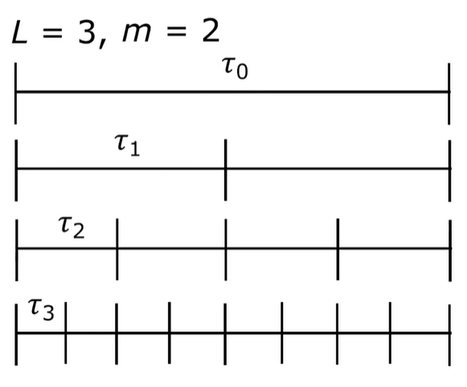

Key Idea: Multilevel Telescoping Sum
For $l=0, 1,…, L$, denote ${\hat{S}}_{l, t }$ as an approximation to $S_{t }$using $τ_{l}∝ m^{−l}$.

Slide 13
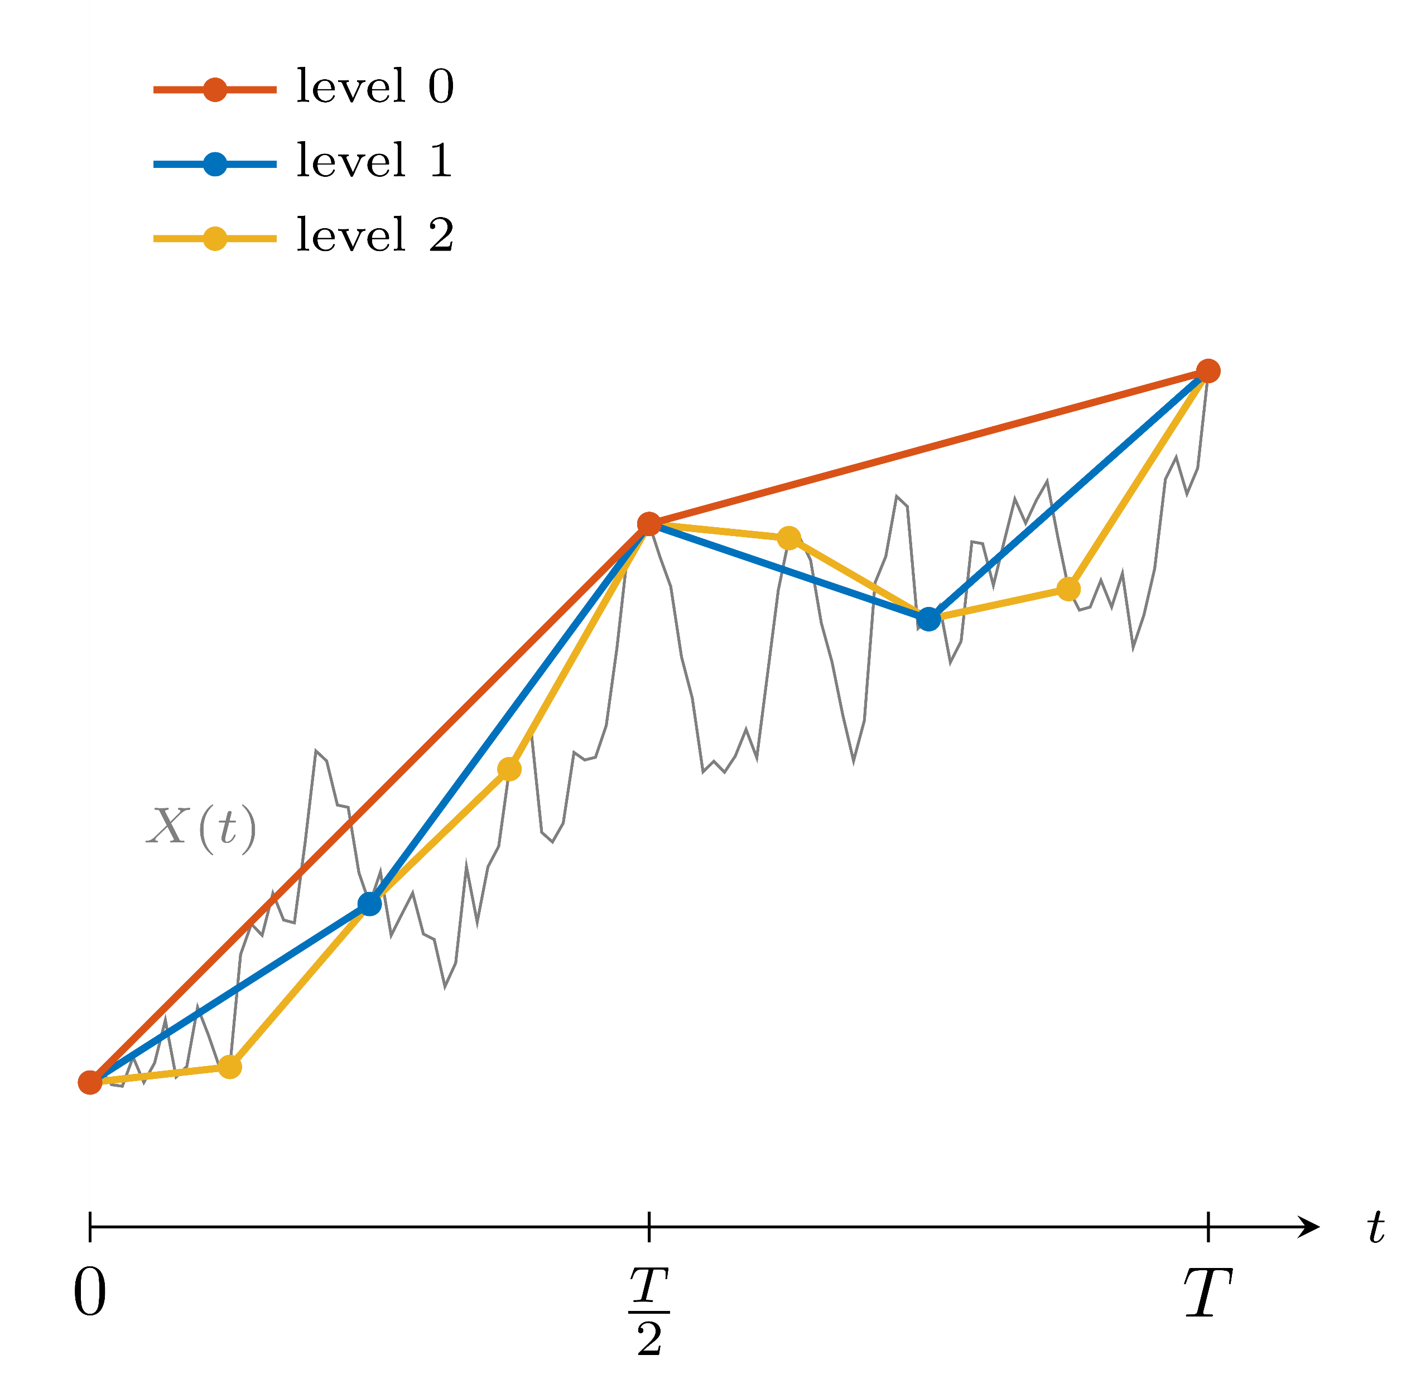
Key Idea: Multilevel Telescoping Sum

Slide 14
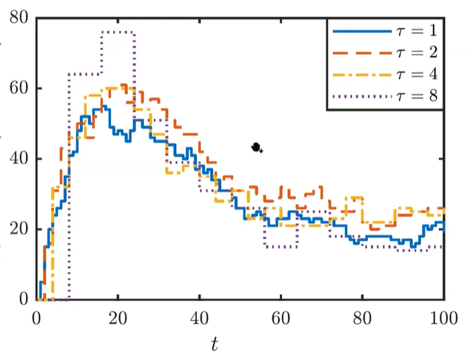
Key Idea: Multilevel Telescoping Sum

Slide 15

Variance Reduction and Optimal Sample Sizes
This scheme induces a positive correlation between () path pairs.
Recall: for correlated r.v. V$\left[X−Y\right]=V\left[X\right]+V\left[Y\right]−C\left[X,Y\right].$
That is we get a variance reduction in the correction estimator.
$${\hat{Y}}_{l}=\frac{1}{N_{l}}\sum_{n=1}^{N_{l}}{{( \hat{P}}_{l}^{\left(n\right)} −{ \hat{P}}_{l−1}^{\left(n\right)})}$$
If we define
$C_{0},V_{0}$ to be cost and variance of ${\hat{P}}_{0}$.
$C_{l},V_{l}$ to be cost and variance of ${\hat{P}}_{l}$ - ${\hat{P}}_{l−1}$.
then the total cost is $\sum_{l=0}^{L}{N_{l}C_{l}}$ and the variance is $\sum_{l=0}^{L}{\frac{1}{N_{l}}}$ $V_{l}$.

Slide 16

Variance Reduction and Optimal Sample Sizes
For target MSE $∝ε^{2}$, we can optimize choice of L and $N_{l}$ for $l=0,1,…,L.$
Choose $N_{l}∝ \sqrt{C_{l}V_{l}}$ so that total variance is less than $\frac{1}{2}$ $ε^{2}$.
Choose L so that ${\left( E\left[{\hat{P}}_{L}\right]−E\left[P\right] \right)}^{2}<\frac{1}{2}$ $ε^{2}$.

Slide 17

Further extension for MLMC Simulation
Multi-index Monte Carlo – Haji-Ali, Nobile, Tempone (2015)
-> important extension to MLMC approach, combining MLMC with sparse grid methods (combination technique).
Standard “1D” MLMC truncates the telescopic sum
$E\left[P\right]= \sum_{l=0}^{∞}{E[∆{\hat{P}}_{l}]}$
where $∆{\hat{P}}_{l}$ = ${\hat{P}}_{l}−{\hat{P}}_{l−1}$ with ${\hat{P}}_{−1}=0.$
In “2D”, MIMC truncates the telescoping sum
$E\left[P\right]= \sum_{l1=0}^{∞}{\sum_{l2=0}^{∞}{E[∆{\hat{P}}_{l1, l2}]}}$
where $∆{\hat{P}}_{l1, l2}$= ${(\hat{P}}_{l1, l2}−{\hat{P}}_{l1−1, l2}) −{(\hat{P}}_{l1, l2−1}−{\hat{P}}_{l1−1, l2−1}).$

Slide 18
Conclusion
Multilevel idea is very simple; key question is how to apply it in new situations, and how to carry out the numerical analysis
Discontinuous output functions can cause problems, but there is a lot of new techniques to cope up with it.
Being used for an increasingly wide range of applications; biggest computational savings when coarsest (reasonable) approximation is much cheaper than finest.
Currently, getting at least 100× savings for SPDEs and stochastic chemical reaction simulations

Slide 19
References
https://www.youtube.com/watch?v=zK1ghzLbrgI
https://www.youtube.com/watch?v=PzrP6HGUAio
https://people.maths.ox.ac.uk/gilesm/files/OPRE_2008.pdf
https://en.wikipedia.org/wiki/Multilevel_Monte_Carlo_method
https://www.uni-kl.de/AG-Heinrich/papers/mmcm01.pdf
https://people.maths.ox.ac.uk/gilesm/files/acta15.pdf
https://eta.impa.br/dl/135.pdf

